Slide 1

Introduction To Machine Learning With R
December 6, 2018
Workflow, Training, Evaluation & Application

Slide 2
Table of Contents
Session Overview
Machine Learning Basics
Workflow
Training, Testing & Evaluation
Estimating Performance
The caret package
Binary classification
Decision Trees
Random Forests
Text classification across multiple topics
Neural Networks

Slide 3
Session Material
Code and data:
https://github.com/rossgore/odu-analytics-course/tree/master/intro-to-machine-learning
Or if its easier: https://bit.ly/2A1Ltwu
Code: code/
Datasets: datasets/
Slides: slides/
Cheatsheet: cheatsheet/

Slide 4
Statistical Analysis vs. Machine Learning
Statistical Analysis:
Focus on interpretability
Assumption Checking
Goal: Draw conclusions about predictors
Machine learning:
Focus on generalizable prediction
Given this data set what algorithm will predict most consistently with other data sets with similar characteristics
Goal: predict as strongly as possible in the future

Slide 5
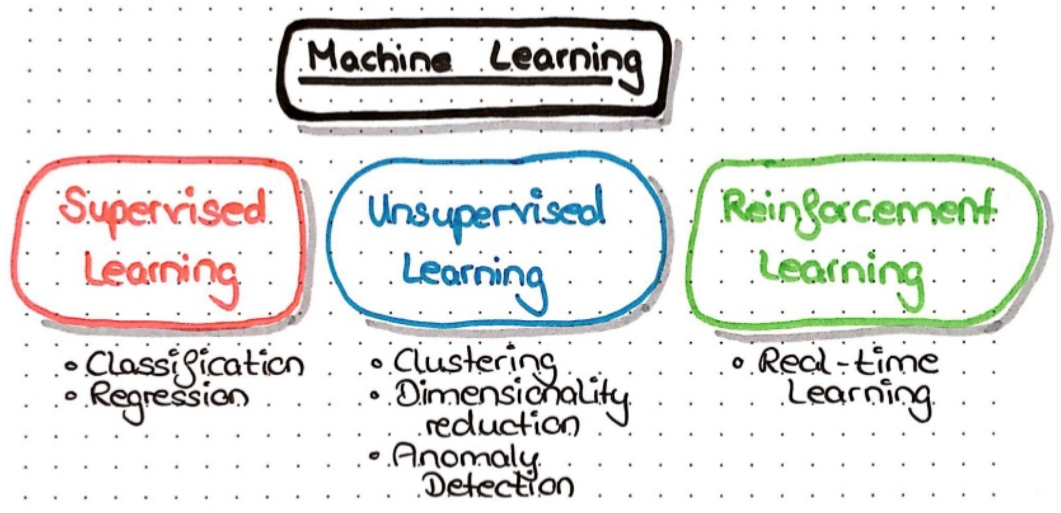
Machine Learning Overview
Notes:
Supervised learning techniques all share the same principles:
The training dataset contains inputs data (your predictors) and the value you want to predict (which can be numeric or not).
The model will use the training data to learn a link between the input and the outputs. Underlying idea is that the training data can be generalized and that the model can be used on new data with some accuracy.
On the other hand, unsupervised learning does not use output data (at least output data that are different from the input). Unsupervised algorithms can be split into different categories:
Clustering algorithm, such as K-means, hierarchical clustering or mixture models. These algorithms try to discriminate and separate the observations in different groups.
Dimensionality reduction algorithms (which are mostly unsupervised) such as PCA, ICA or autoencoder. These algorithms find the best representation of the data with fewer dimensions.
Anomaly detections to find outliers in the data, i.e. observations which do not follow the data set patterns.
Reinforcement learning algorithms try to find the best ways to earn the greatest reward by following these circular steps:
Given its and the environment’s states, the agent will choose the action which will maximize its reward or will explore a new possibility. These actions will change the environment’s and the agent states. They will also be interpreted to give a reward to the agent. By performing this loop many times, the agents will improve its behavior.

Slide 6
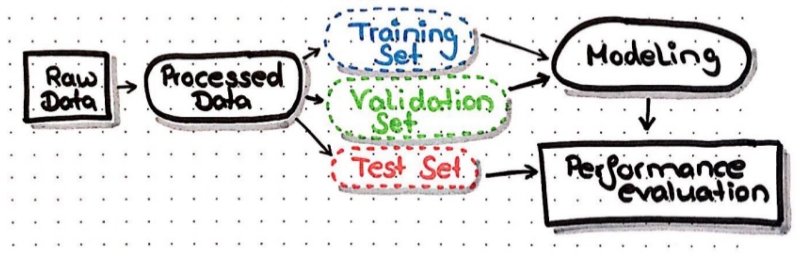
The General Workflow
Input data
Data preprocessing
Training, validation and test split
Modeling
Predictions and Evaluations

Slide 7
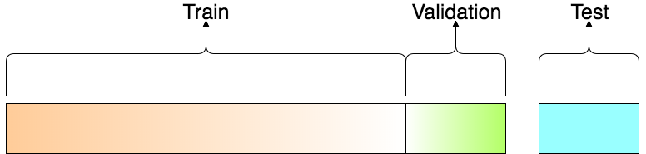
Model Building Steps
Common steps during model building
Estimating model parameters
Determining the values of tuning parameters that cannot be directly calculated from data
Calculating the performance of the final model that will generalize to new data
How do we spend the data to find an optimal model?
Notes:
Training set: A set of examples used for learning, that is to fit the parameters [i.e., weights] of the classifier.
Validation set: A set of examples used to select the model / tune the parameters [i.e., architecture, not weights] of a classifier, for example to choose the number of hidden units in a neural network.
Test set: A set of examples used only to assess the performance [generalization] of a fully specified classifier.

Slide 8
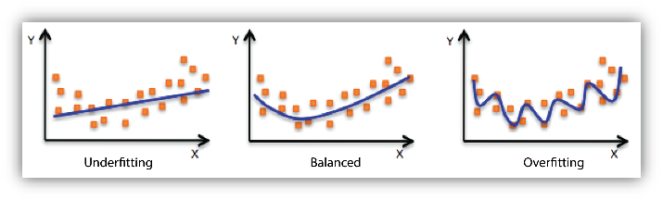
Spending Our Data
The more data we spend, the better estimates we’ll get. Given a fixed amount of data:
Too much spent in training won’t allow us to get a good assessment of predictive performance (over-fitting)
Too much spend in testing won’t allow us to get a good assessment of model structure & parameters (under-fitting)

Slide 9
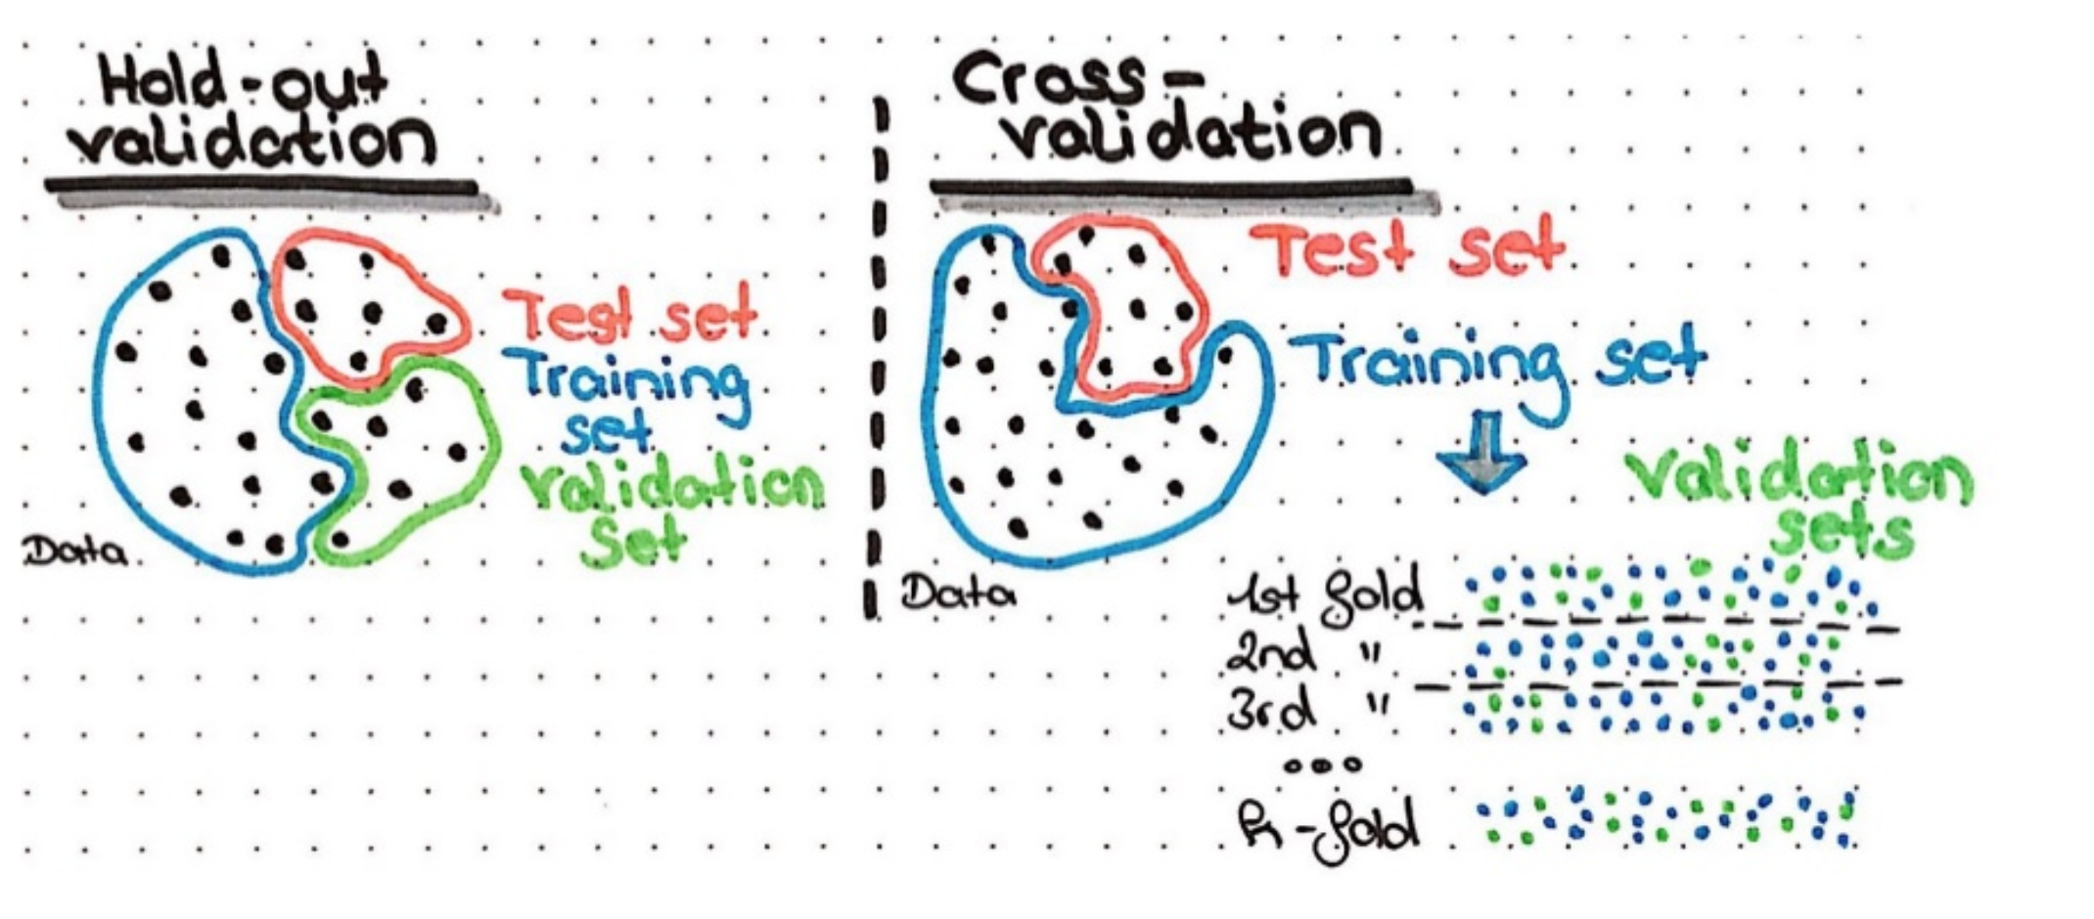
Training, Testing & Validation
Balance between generalization & specificity
Prevents Overfitting!
Validation sets or cross-validation

Slide 10
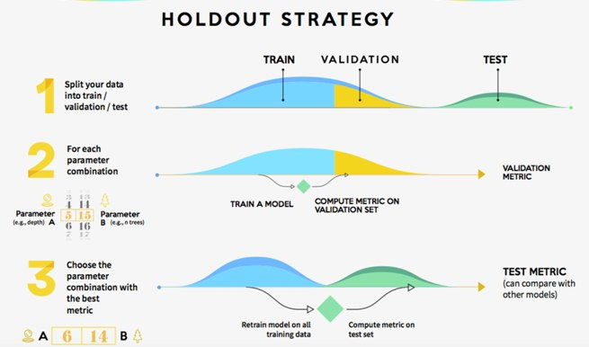
Hold-out Validation
One set used to train the model
One set used to tune/select the model – validation set
One set used to assess the model (i.e. error) – test set

Slide 11
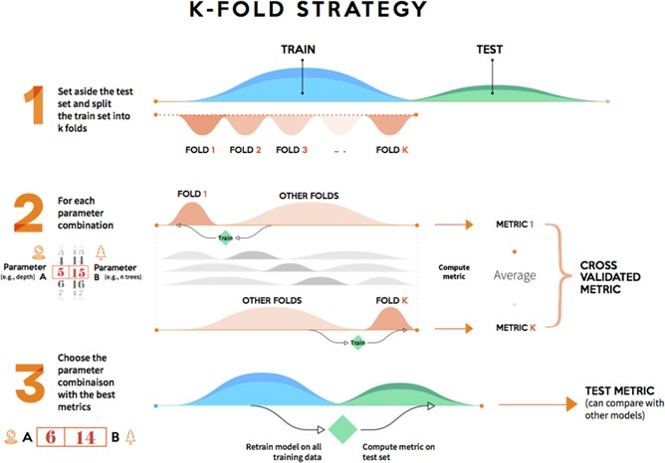
Cross Validation
Using the training data
Randomly split the data into K blocks of equal size
For k times (folds):
Hold out the block k and fit the model with the remaining training data
Using the model you fit predict the hold out block (i.e. block k)
Model selection is based on how well the model predicted all of the hold out blocks
Test set used to assess the model

Slide 12
Cross Validation
Notes:
Pros of the hold-out strategy: Fully independent data; only needs to be run once so has lower computational costs.
Cons of the hold-out strategy: Performance evaluation is subject to higher variance given the smaller size of the data.
Pros of the K-fold strategy: Prone to less variation because it uses the entire training set.
Cons of the K-fold strategy: Higher computational costs; the model needs to be trained K times at the validation step (plus one more at the test step).

Slide 13
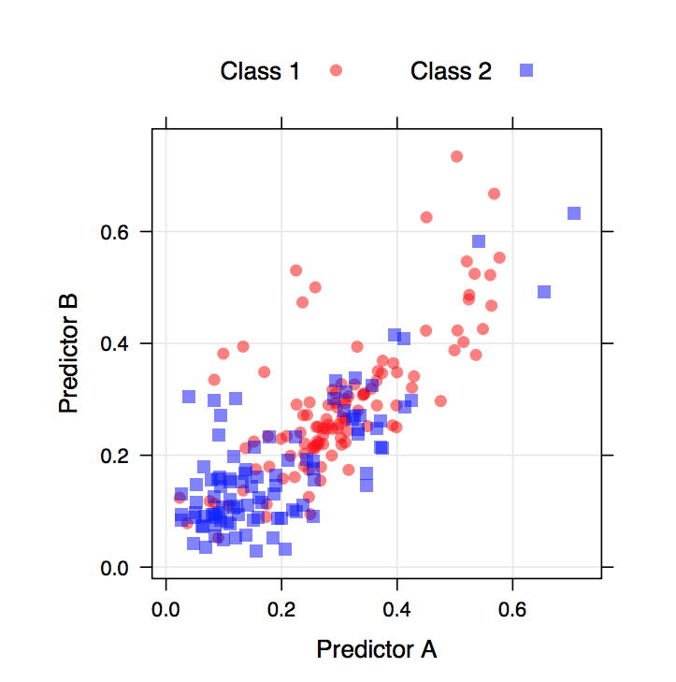
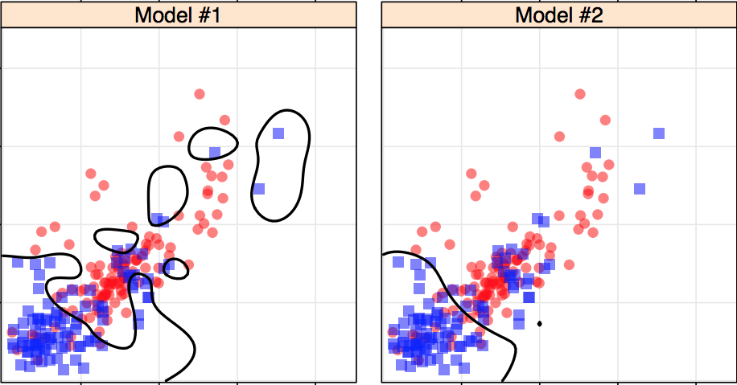
Estimating Performance
Look at the data on the left
Which model is more accurate given the data shown?
Which model would you prefer to use?

Slide 14
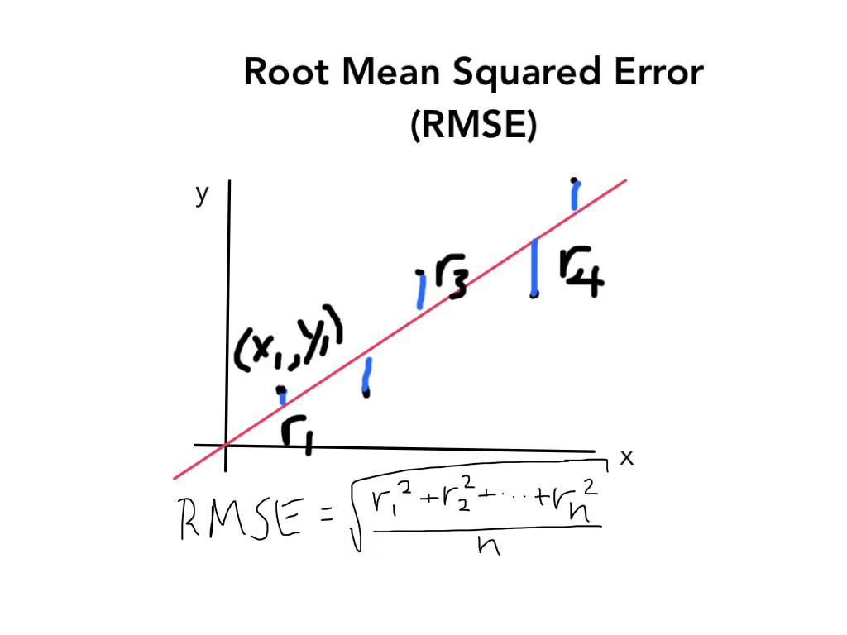
Estimating Performance
Once you have a set of predictions, various metrics can be used to evaluate performance
For Regression:
R² is popular. Should be adjusted for model complexity.
MAE and RMSE – effective and common metrics
Spearman correlation useful in situations where rank is important.
What about for classification models?

Slide 15
Estimating Performance
Two-Classification Models (Binary):
Sensitivity:
Given that a result is truly an event, what is the probability that the model will predict an event results?
Specificity:
Given that a result is truly not an event, what is the probability that the model will predict a negative results?
Here event is the “event” of interest

Slide 16
Estimating Performance
Given a SPAM classification model:
Sensitivity =
Specificity =

Slide 17
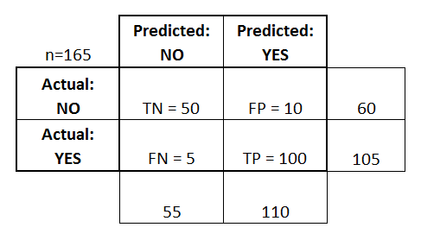
Estimating Performance
Classification Models:
Confusion Matrix
Cross tabulation of the observed and predicted classes

Slide 18
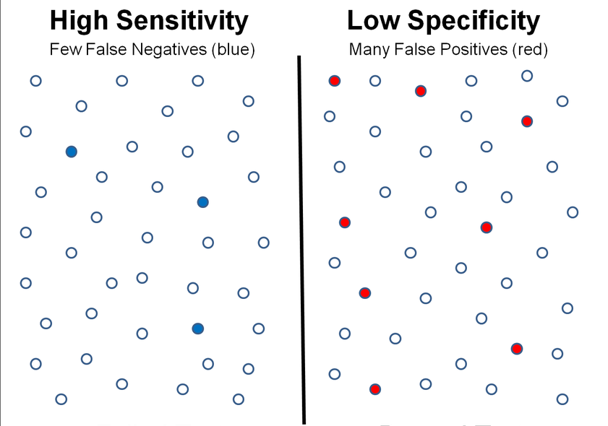
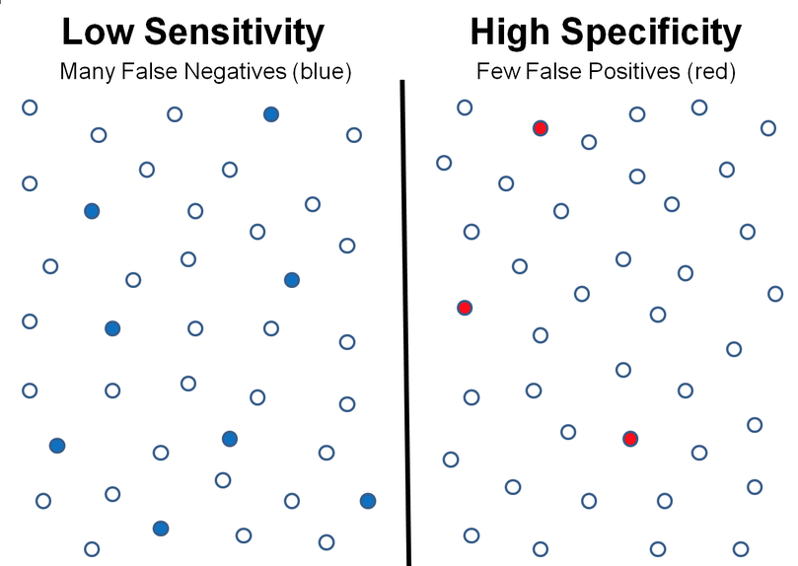
Sensitivity & Specificity
Ideally we want both to be high but what do tradeoffs look like?

Slide 19
Classification Threshold
Classifiers produce a probability that an item belongs to certain classification category.
Example: There is a 80% chance this email is SPAM.
Classification Threshold - value separating classification categories
At and above that threshold indicates "spam”
Value below indicates "not spam."
It is tempting to assume that the classification threshold should always be 0.5, but thresholds are problem-dependent, and are therefore values that you must tune.
Many problems where it is far better to “cry wolf” than worse to “miss classifying an event”
Example: Cancer Detection

Slide 20
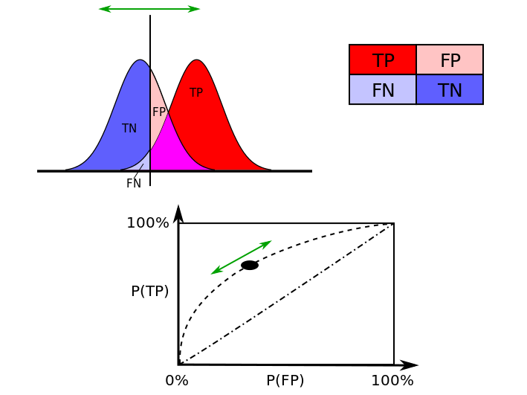
ROC
With two classes the Receiver Operating Characteristic (ROC) curve can be used to estimate performance using a combination of sensitivity and specificity:
The ROC curve plots the sensitivity (true positive rate) by 1 – specificity (false positive rate) at different classification thresholds.
Lowering the classification threshold classifies more items as positive, thus increasing both False Positives and True Positives
Notes:
For a perfect classifier the ROC curve will go straight up the Y axis and then along the X axis. A classifier with no power will sit on the diagonal, whilst most classifiers fall somewhere in between.
ROC analysis provides tools to select possibly optimal models and to discard suboptimal ones independently from (and prior to specifying) the cost context or the class distribution.
Threshold Selection
It is immediately apparent that a ROC curve can be used to select a threshold for a classifier which maximises the true positives, while minimising the false positives.
However, different types of problems have different optimal classifier thresholds. For a cancer screening test, for example, we may be prepared to put up with a relatively high false positive rate in order to get a high true positive, it is most important to identify possible cancer sufferers.
For a follow-up test after treatment, however, a different threshold might be more desirable, since we want to minimise false negatives, we don’t want to tell a patient they’re clear if this is not actually the case.

Slide 21
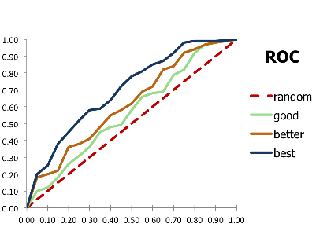
AUC
AUC stands for "Area under the ROC Curve.”
Measures the entire two-dimensional area underneath the entire ROC curve.
More area under the curve, the better.
Notes:
Performance Assessment
ROC curves also give us the ability to assess the performance of the classifier over its entire operating range. The most widely-used measure is the area under the curve (AUC). As you can see from Figure 2, the AUC for a classifier with no power, essentially random guessing, is 0.5, because the curve follows the diagonal. The AUC for that mythical being, the perfect classifier, is 1.0. Most classifiers have AUCs that fall somewhere between these two values.
An AUC of less than 0.5 might indicate that something interesting is happening. A very low AUC might indicate that the problem has been set up wrongly, the classifier is finding a relationship in the data which is, essentially, the opposite of that expected. In such a case, inspection of the entire ROC curve might give some clues as to what is going on: have the positives and negatives been mislabelled?

Slide 22
AUC
AUC Provides an aggregate measure across all possible classification thresholds
Probability that the model ranks a random actual positive to the right of a random actual negative.
If the model never does this AUC = 0. If the model always does this AUC = 1.0.
Notes:
AUC provides an aggregate measure of performance across all possible classification thresholds. One way of interpreting AUC is as the probability that the model ranks a random positive example more highly than a random negative example. For example, given the following examples, which are arranged from left to right in ascending order of logistic regression predictions:
AUC represents the probability that a random positive (green) example is positioned to the right of a random negative (red) example.
AUC ranges in value from 0 to 1. A model whose predictions are 100% wrong has an AUC of 0.0; one whose predictions are 100% correct has an AUC of 1.0.
AUC is desirable for the following two reasons:
AUC is scale-invariant. It measures how well predictions are ranked, rather than their absolute values.
AUC is classification-threshold-invariant. It measures the quality of the model's predictions irrespective of what classification threshold is chosen.
However, both these reasons come with caveats, which may limit the usefulness of AUC in certain use cases:
Scale invariance is not always desirable. For example, sometimes we really do need well calibrated probability outputs, and AUC won’t tell us about that.
Classification-threshold invariance is not always desirable. In cases where there are wide disparities in the cost of false negatives vs. false positives, it may be critical to minimize one type of classification error. For example, when doing email spam detection, you likely want to prioritize minimizing false positives (even if that results in a significant increase of false negatives). AUC isn't a useful metric for this type of optimization.

Slide 23
Estimating Performance
Classification Models:
Confusion Matrix
Cross tabulation of the observed and predicted classes

Slide 24

Estimating Performance
Classification Models:
Overall accuracy can be used. But problematic when the classes (i.e types being classified) are not balanced.
Kappa Statistic takes into account the classifications you should get right based on chance:
O is the observed accuracy
E is the expected accuracy under chance agreement
Notes:
The Kappa statistic (or value) is a metric that compares an Observed Accuracy with an Expected Accuracy (random chance) Tt takes into account random chance (agreement with a random classifier), which generally means it is less misleading than simply using accuracy as a metric (an Observed Accuracy of 80% is a lot less impressive with an Expected Accuracy of 75% versus an Expected Accuracy of 50%).
Observed Accuracy is simply the number of instances that were classified correctly throughout the entire confusion matrix.
Expected Accuracy is defined as the accuracy that any random classifier would be expected to achieve based on the confusion matrix. The Expected Accuracy is directly related to the number of instances of each class, along with the number of instances that the machine learning classifier agreed with the ground truth label.
From previous slide:

Slide 25
Estimating Performance
Kappa:
Observed Accuracy: (50+100)/165 = 0.9090909
Expected Accuracy: = ( ((55*60)/165) + ((110*105)/165) ) /165 =0.5454545
Kappa = (0.9090909 - 0.5454545) / (1 - 0.5454545) = 0.8
Notes:
In essence, the kappa statistic is a measure of how closely the instances classified by the machine learning classifier matched the data labeled as ground truth, controlling for the accuracy of a random classifier as measured by the expected accuracy. Not only can this kappa statistic shed light into how the classifier itself performed, the kappa statistic for one model is directly comparable to the kappa statistic for any other model used for the same classification task.

Slide 26

ML with caret

Slide 27
The caret Package
The caret package was developed to:
Create a unified interface for modeling and prediction (interfaces to 147 different modeling techniques)
Streamline model training and testing
Provide a variety of helper functions for model building
Increase computational efficiency with parallel processing support

Slide 28
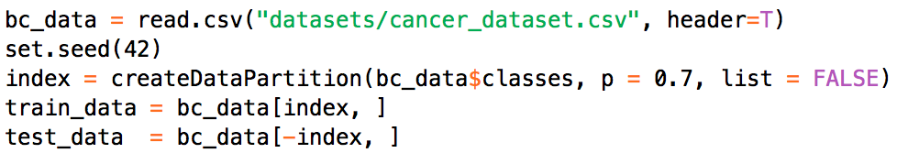
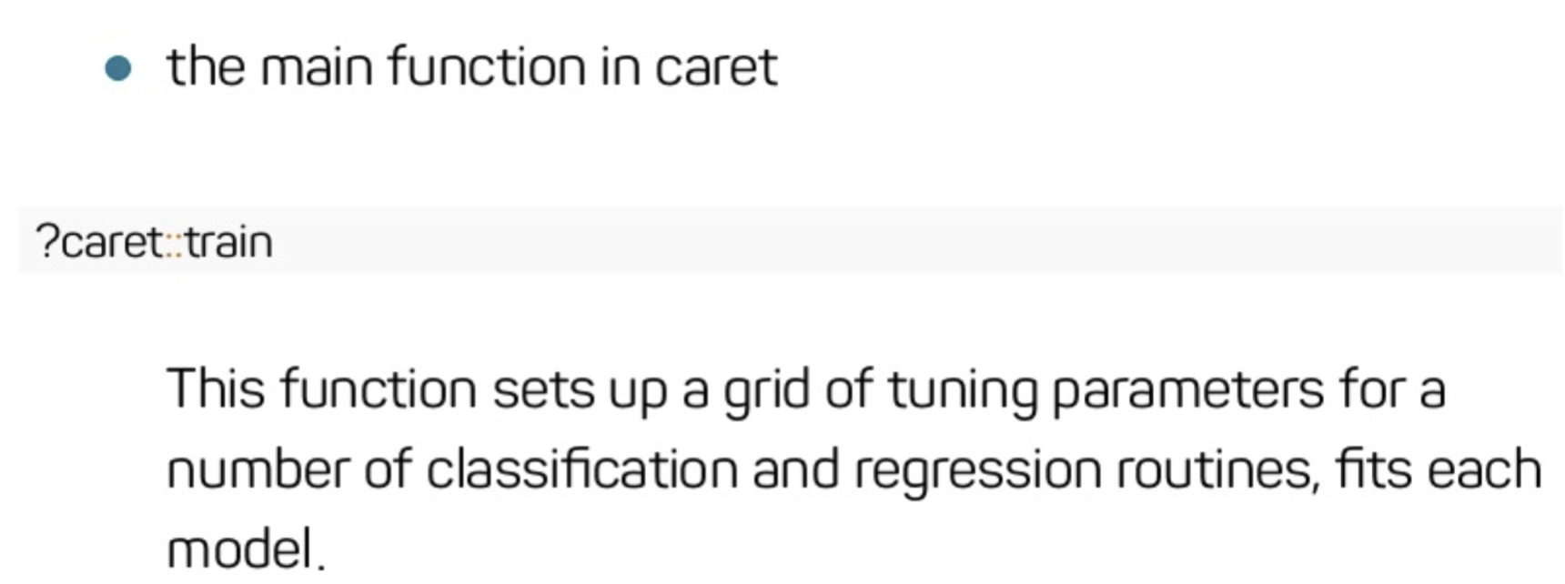
Setting up a caret model

Slide 29
Single Decision Trees
Pros
Computed very quickly and have simple interpretations.
Built-in feature selection – if a predictor variable is not used the model is independent of it.
Cons
Usually do not have optimal performance
Small changes in training data can drastically affect structure

Slide 30
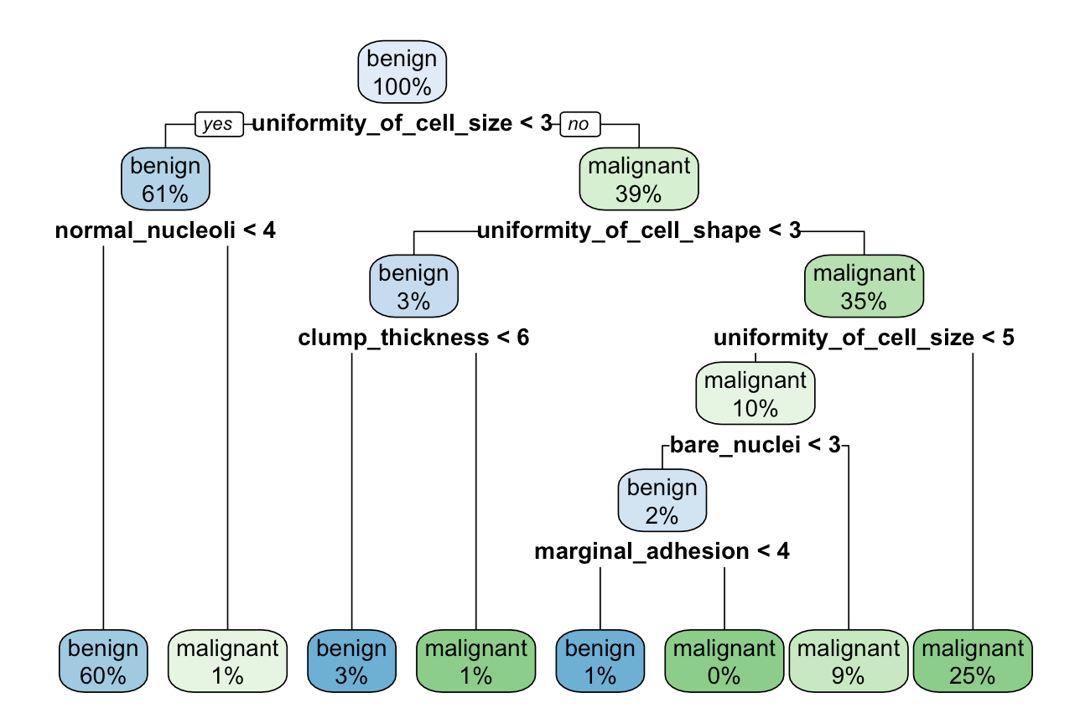
Decision Trees

Slide 31
Random Forests
Compensate for single decision tree drawback
small changes in training data can drastically affect structure
How?
Fit many trees and aggregate predictions across the trees
Train each tree on different data
Each tree uses different predictor variables
Result: More robust, lower likelihood model is overfit

Slide 32

Random Forests

Slide 33
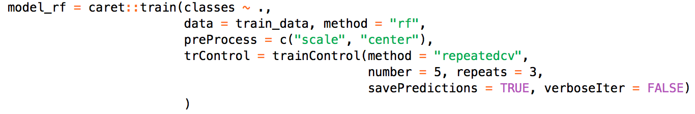
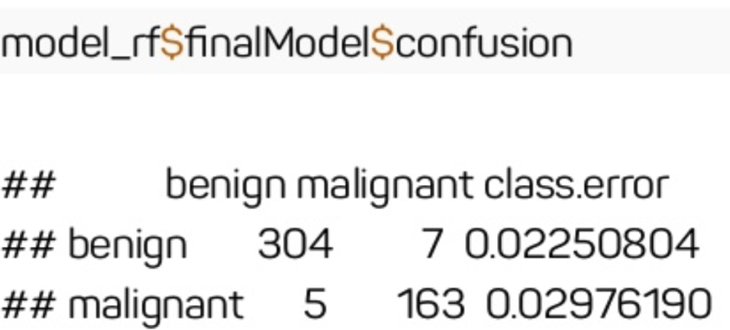
Random Forests

Slide 34
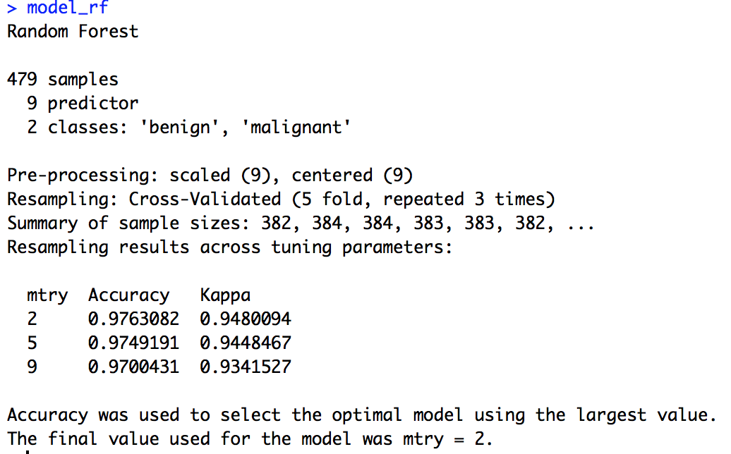
Random Forests

Slide 35
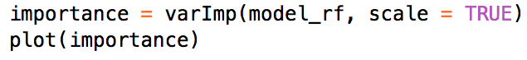
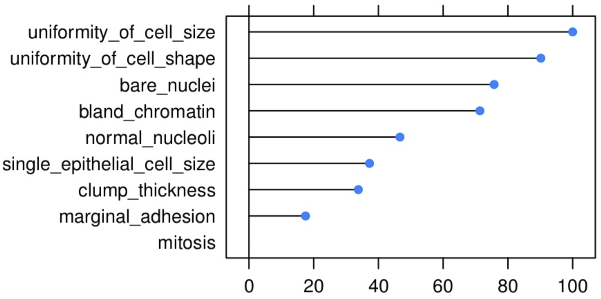
Feature Importance

Slide 36
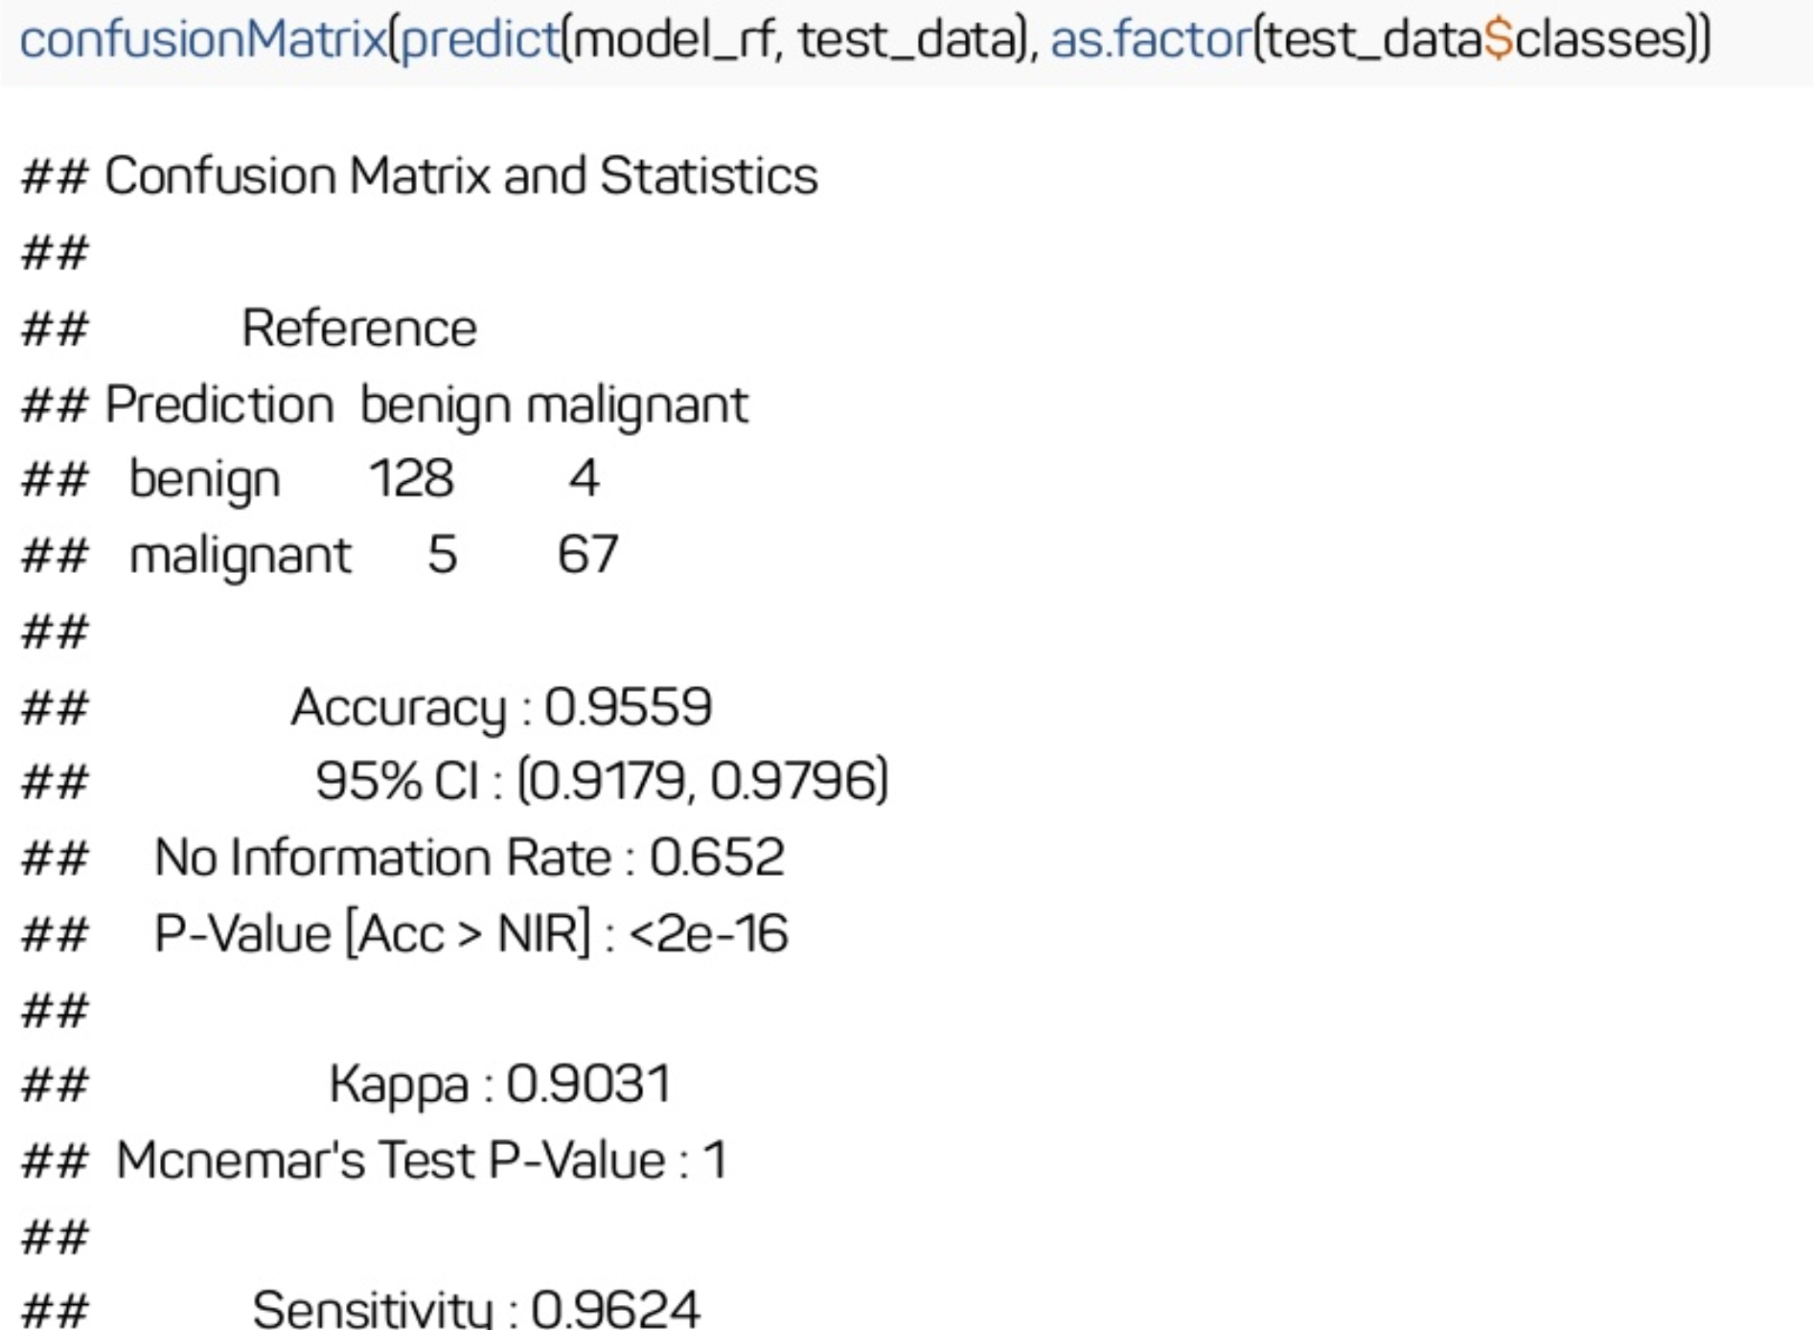
Predictions on Test Data

Slide 37
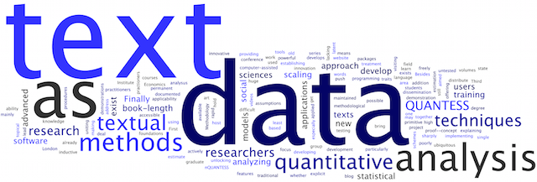
What if our data is text?

Slide 38
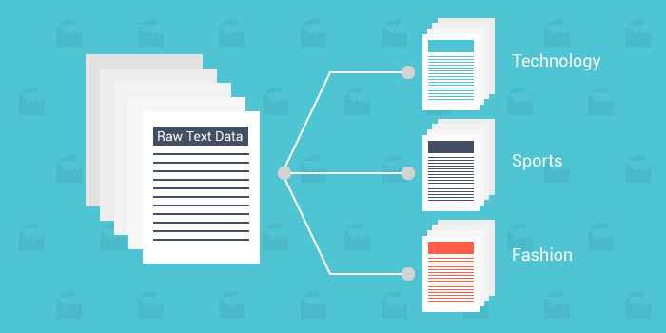
Text Classification
Common Task: Hand coding a set of documents for multiple variables of interest
What if we only had to manually code a small set of the documents and then we could train a model to do the rest?
Of course we will need to know the effectiveness of our model.

Slide 39

The Documents
Set of hand-labeled bills from Congress
Each bill text description of the bill’s purpose
“To amend the Immigration and Nationality Act in regard to Caribbean-born immigrants.”
Also has major policy topic code for the subject of the bill.
20 major topic codes
Including: Macroeconomics, Civil Rights, Health

Slide 40
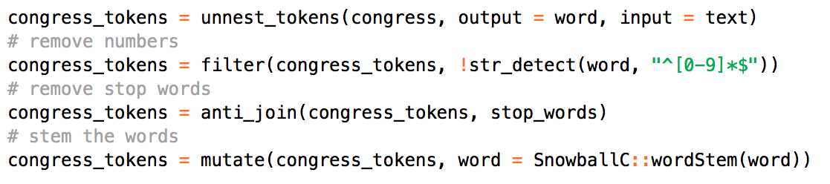
Get The Data and Put It In a Data Frame

Slide 41

What did we just do?
unnest_tokens(output = word, input = text) - converts the data frame to data frame where each row is a word and automatically converts all words to lowercase.
filter(!str_detect(word, "^[0-9]*$")) - removes all tokens which are strictly numbers.
Numbers are generally not useful features in classifying documents.

Slide 42
What did we just do?
anti_join(stop_words) - remove common stop words that are uninformative and will likely not be useful in predicting major topic codes.
mutate(word = SnowballC::wordStem(word)))- stem all the tokens to their root word

Slide 43
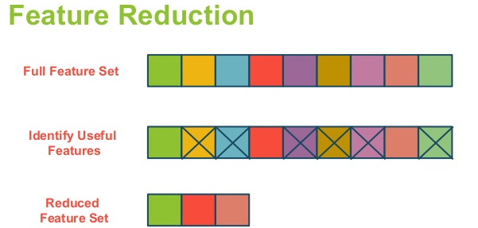
Why did we do it?
These steps are to reduce the number of text features in the set of documents.
This is necessary because as you increase the number of observations (i.e. documents) and variables/features (i.e. tokens/words), the resulting statistical learning model will become more complex and harder to compute.
We did not have this issue before because the features were defined for us.

Slide 44
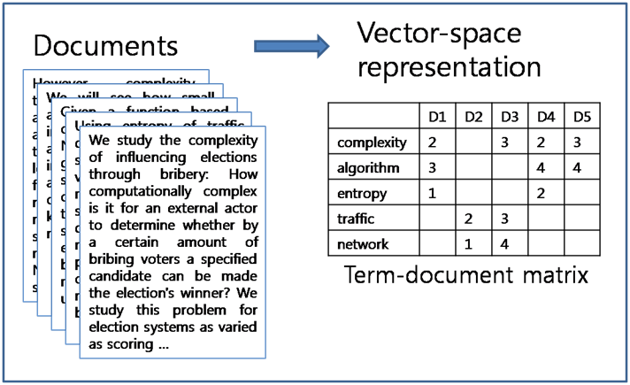
Create a document term matrix

Slide 45
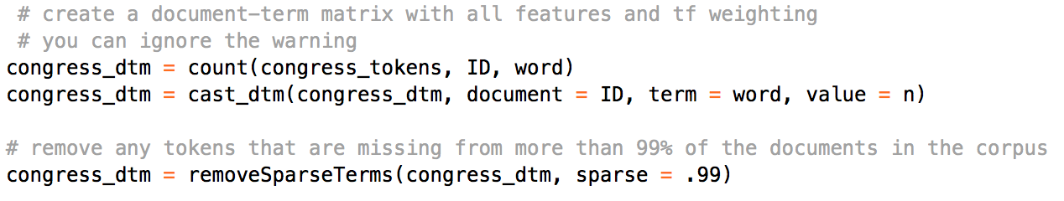
Create a document term matrix

Slide 46
What did we just do?
cast_dtm(document = ID, term = word, value = n)) - created a document term matrix with 4449 rows and 209 columns.
In other words we have created a matrix of how 209 different words are used across the 4449 documents
Why only 209 words, surely there have to be more?
removeSparseTerms(congress_dtm, sparse = .99)

Slide 47
Sparsity
removeSparseTerms(congress_dtm, sparse = .99)
We can reduce model complexity by removing tokens (i.e. terms) which do not appear across many documents. Directly deletes sparse terms from the document-term matrix. This results in a statistical learning model with a much smaller set of features.

Slide 48
Exploratory Analysis w/ tf-idf
Before building our model, we can first investigate if there are certain terms or tokens associated with each major topic category
To do this we calculate the term-frequency inverse document frequency (i.e. tf-idf) for each term treating each major topic code as the document

Slide 49
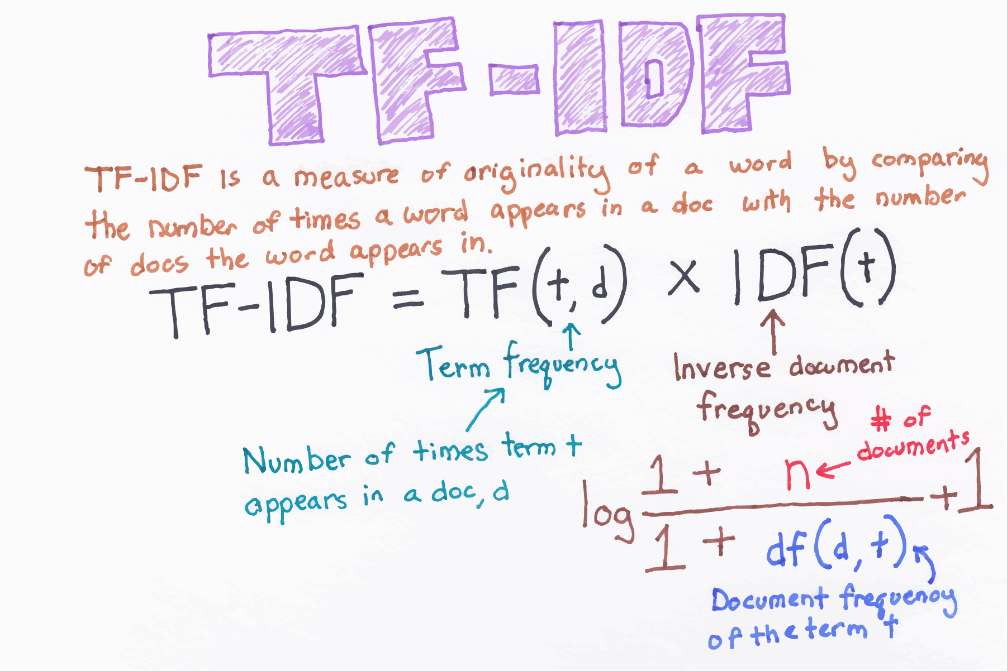
Tf-idf

Slide 50
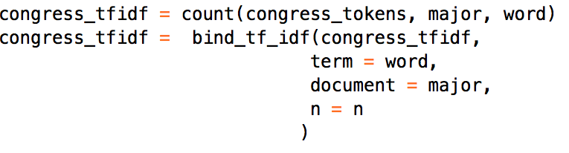
Exploratory Analysis w/ tf-idf
To calculate tf-idf directly in the data frame, first we count() the frequency each token appears in bills from each major topic code, then use bind_tf_idf() to calculate the tf-idf for each token in each topic

Slide 51
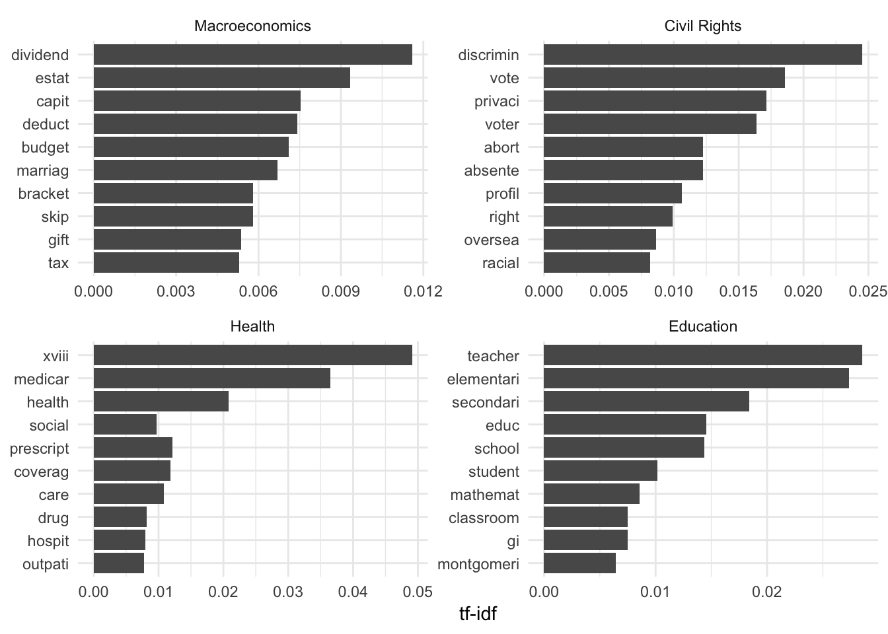
See top tf-idf words for 4 topics

Slide 52
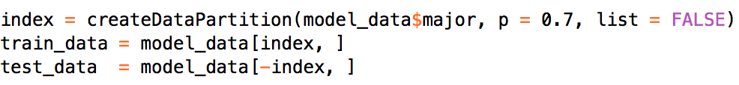
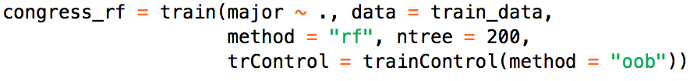
Estimate Model
Exploratory analysis suggests there are some useful features in the text.
Now we need to train and test the model

Slide 53
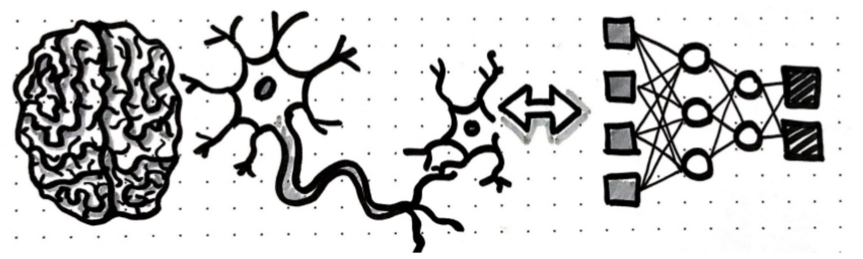
Introduction to Neural Networks (NN)
Machine Learning Framework
Attempts to mimic patterns of the brain
Artificial Neural Networks = ANNs

Slide 54
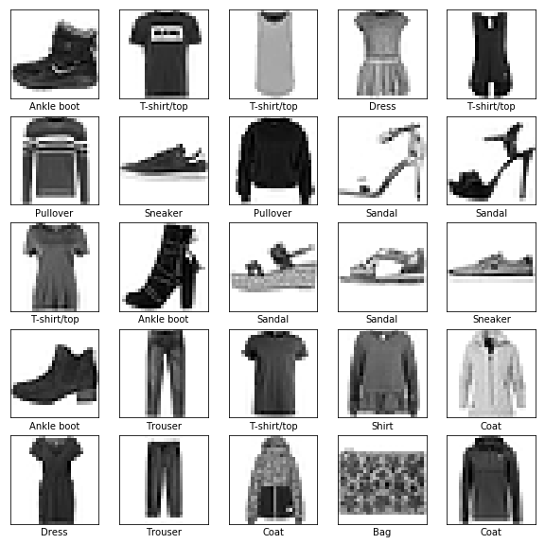
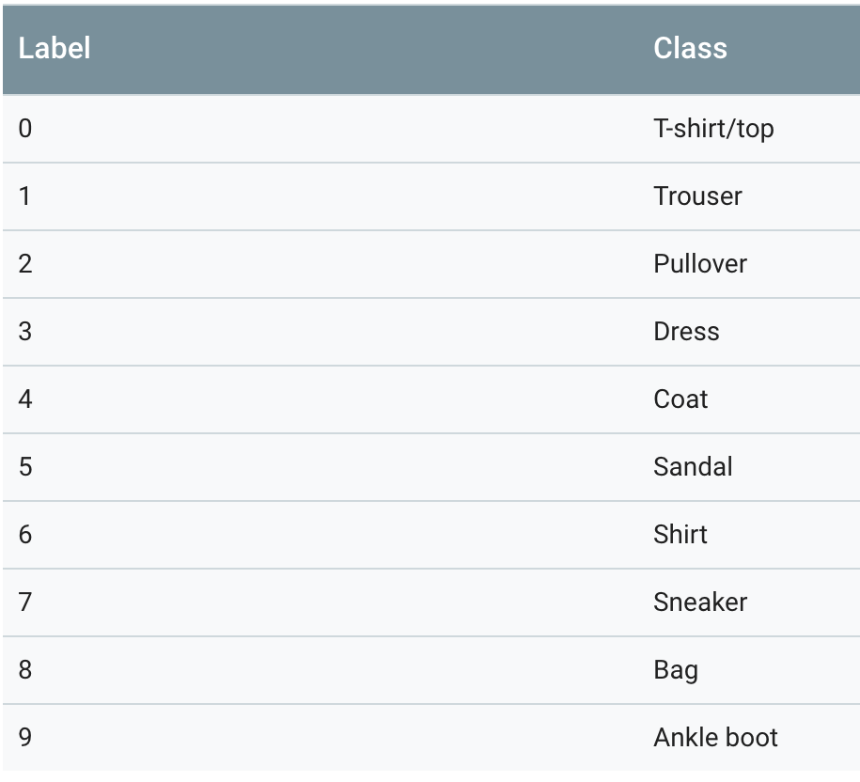
Overview / Example

Slide 55

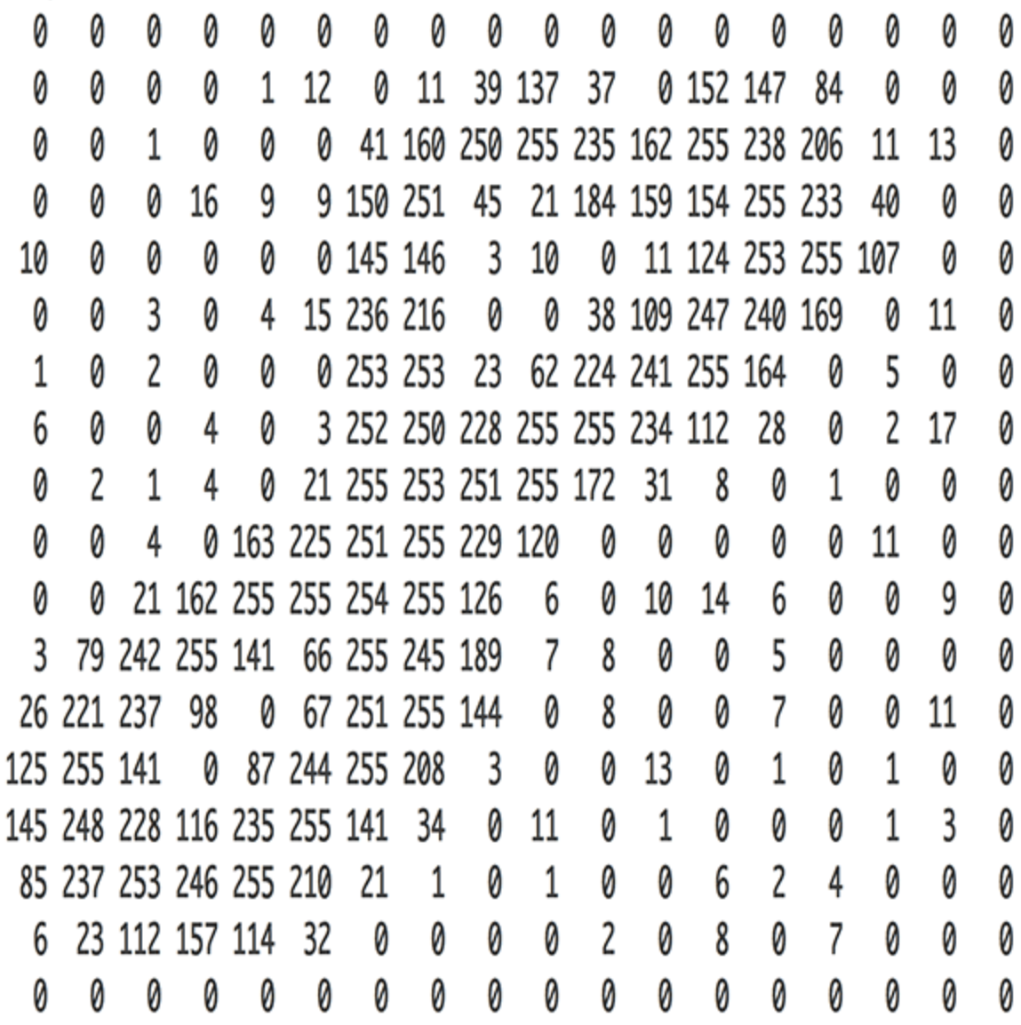
Overview / Example

Slide 56
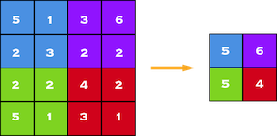
Overview / Example
Obviously the number of inputs can get massive so we introduce abstraction by dividing up the pixels into small subsectors

Slide 57
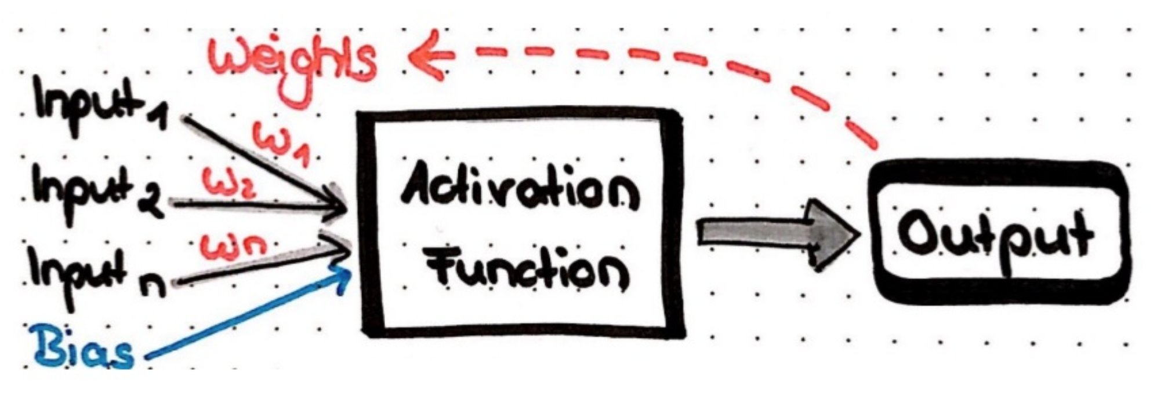
Perceptrons
Input (multiplied by weight)
Bias
Activation function
Output
Notes:
Perceptron is usually used to classify the data into two classes.
The perceptron works on these simple steps
a. All the inputs are multiplied with their weights w.
b. Add all the multiplied values and call them Weighted Sum.
c. Apply that weighted sum to the Activation Function.
Why do we need Weights and Bias?
Weights shows the strength of the particular node.
A bias value allows you to shift the activation function curve up or down.
In short, the activation functions are used to map the input between the required values like (0, 1) or (-1, 1).

Slide 58
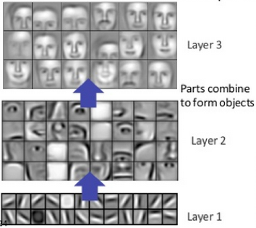
Perceptrons
Input (multiplied by weight)
Bias
Activation function
Output
Notes:
In neural networks, each layer of nodes trains on a distinct set of features based on the previous layer’s output. The further you advance into the neural net, the more complex the features your nodes can recognize, since they aggregate and recombine features from the previous layer.
This is known as feature hierarchy, and it is a hierarchy of increasing complexity and abstraction. It makes neural networks capable of handling very large, high-dimensional data sets with billions of parameters that pass through nonlinear functions.

Slide 59
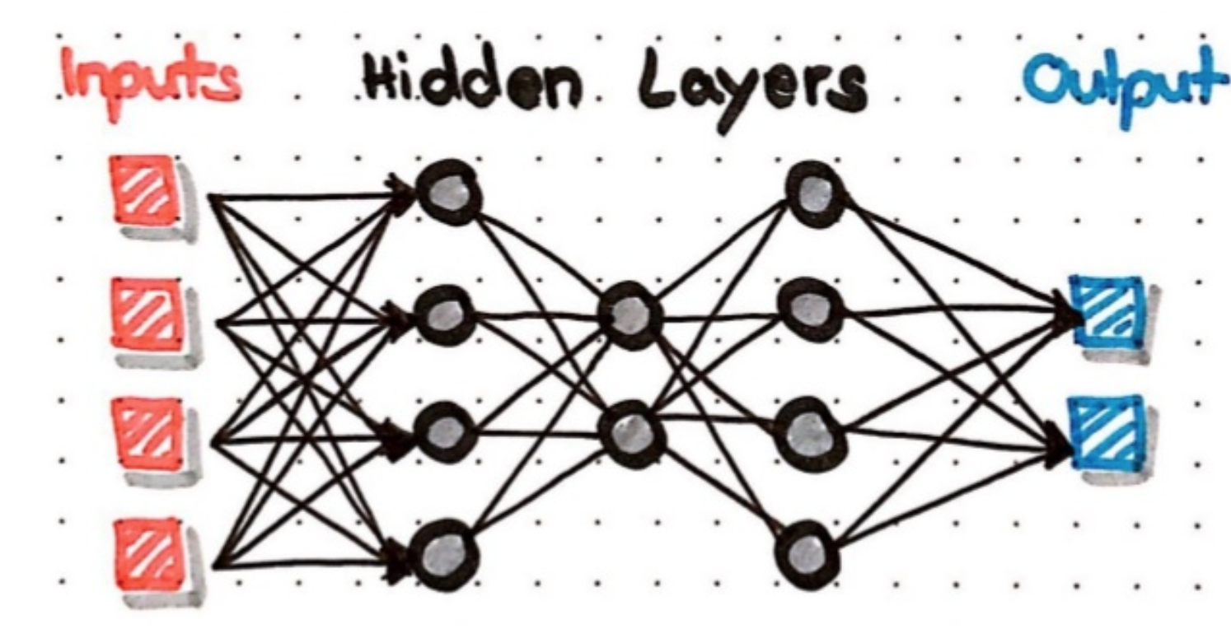
Multi-Layer Perceptrons
Multiple layers of perceptrons
Input
Output
Hidden Layers
Notes:
Input or Visible Layers
The bottom layer that takes input from your dataset is called the visible layer, because it is the exposed part of the network. Often a neural network is drawn with a visible layer with one neuron per input value or column in your dataset. These are not neurons as described above, but simply pass the input value though to the next layer.
Hidden Layers
Layers after the input layer are called hidden layers because that are not directly exposed to the input. The simplest network structure is to have a single neuron in the hidden layer that directly outputs the value.
Given increases in computing power and efficient libraries, very deep neural networks can be constructed. Deep learning can refer to having many hidden layers in your neural network. They are deep because they would have been unimaginably slow to train historically, but may take seconds or minutes to train using modern techniques and hardware.
Output Layer
The final hidden layer is called the output layer and it is responsible for outputting a value or vector of values that correspond to the format required for the problem.

Slide 60

How do Neural Nets Learn?

Slide 61
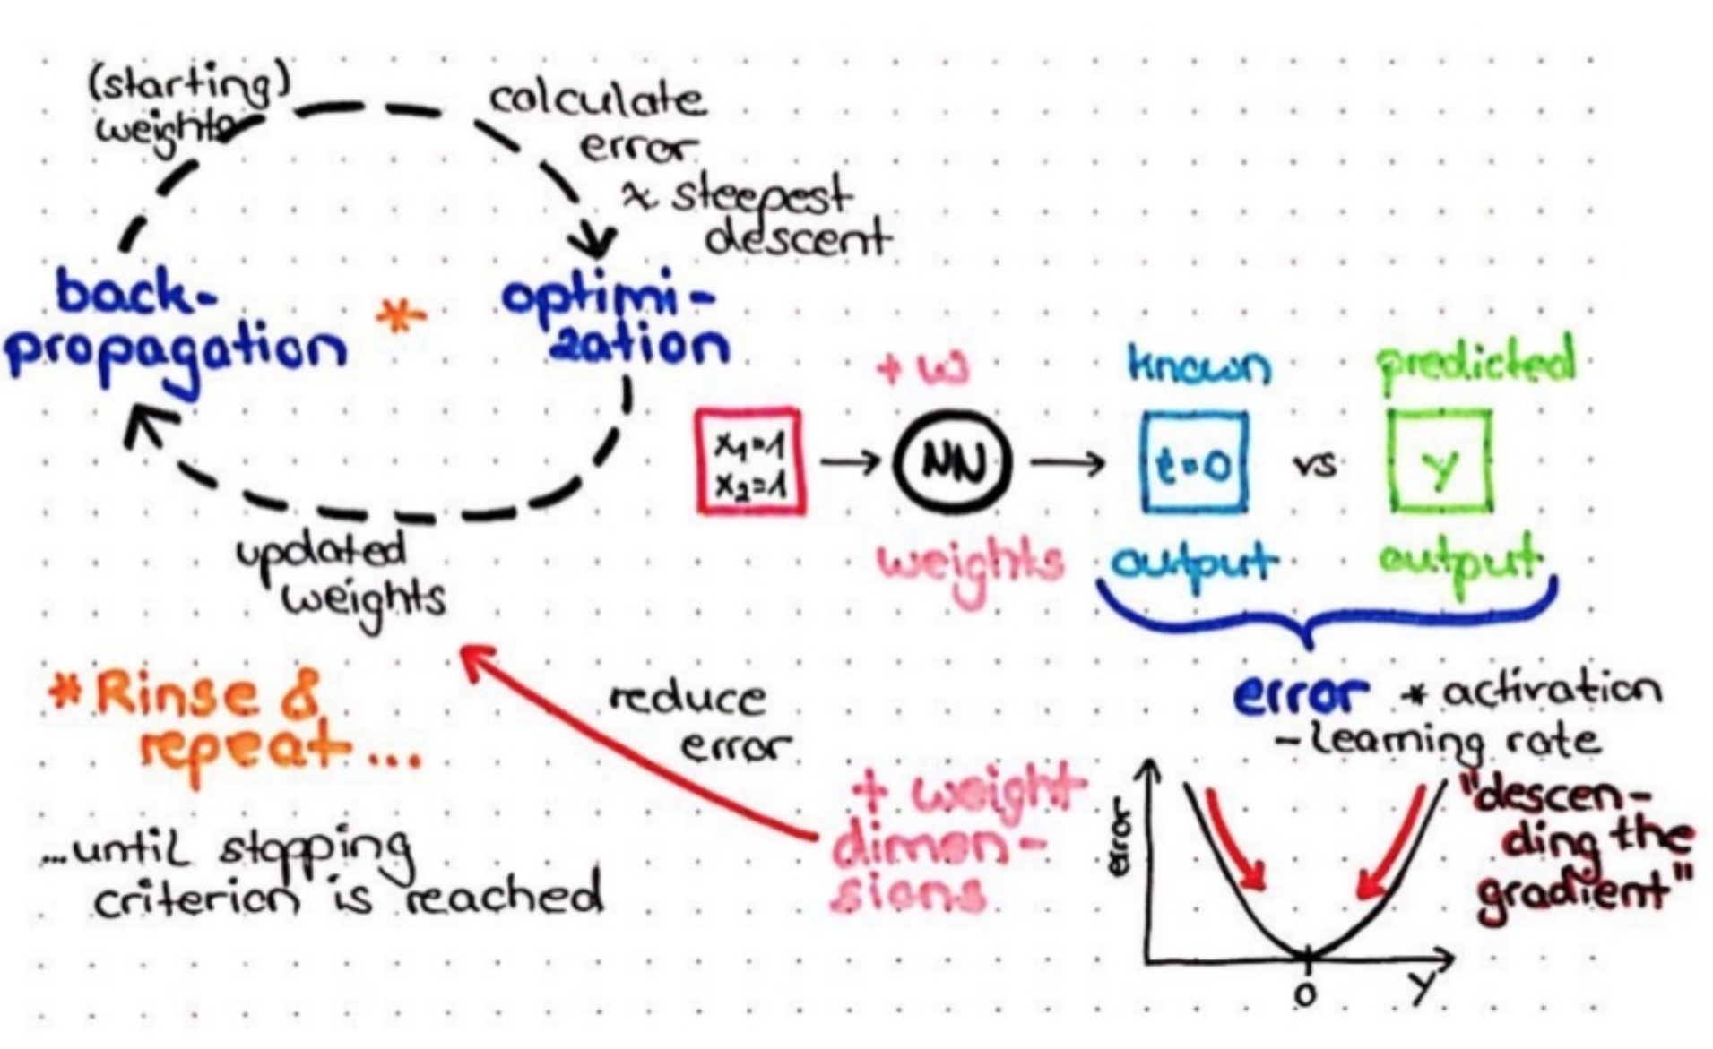
Training a Neural Network
Notes:
Stochastic Gradient Descent
The classical and still preferred training algorithm for neural networks is called stochastic gradient descent.
This is where one row of data is exposed to the network at a time as input. The network processes the input upward activating neurons as it goes to finally produce an output value. This is called a forward pass on the network. It is the type of pass that is also used after the network is trained in order to make predictions on new data.
The output of the network is compared to the expected output and an error is calculated. This error is then propagated back through the network, one layer at a time, and the weights are updated according to the amount that they contributed to the error. This clever bit of math is called the backpropagation algorithm.
The process is repeated for all of the examples in your training data. One of updating the network for the entire training dataset is called an epoch. A network may be trained for tens, hundreds or many thousands of epochs.
Weight Updates
The weights in the network can be updated from the errors calculated for each training example and this is called online learning. It can result in fast but also chaotic changes to the network.
Alternatively, the errors can be saved up across all of the training examples and the network can be updated at the end. This is called batch learning and is often more stable.
The network topology and the final set of weights is all that you need to save from the model. Predictions are made by providing the input to the network and performing a forward-pass allowing it to generate an output that you can use as a prediction.

Slide 62
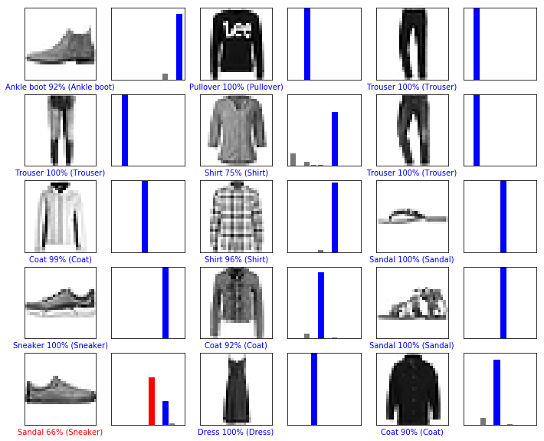
Results of a Neural Network
Output is the same as other machine learning methods
Probability for each category
Item classified into category with the highest probability
Can view results as a confusion matrix

Slide 63
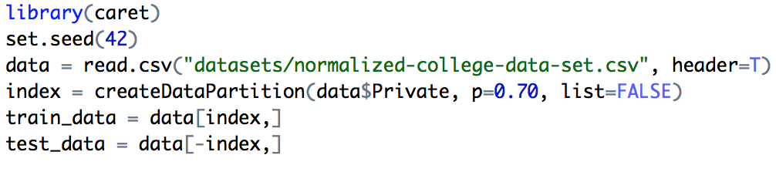
Train and Test Split

Slide 64
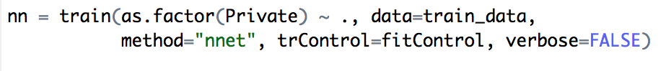
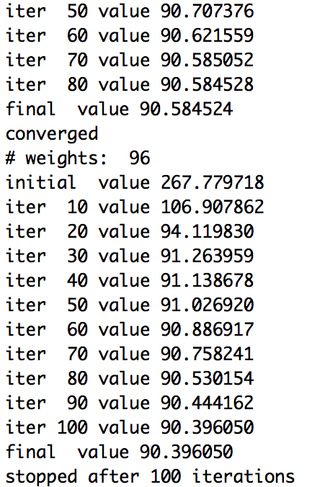
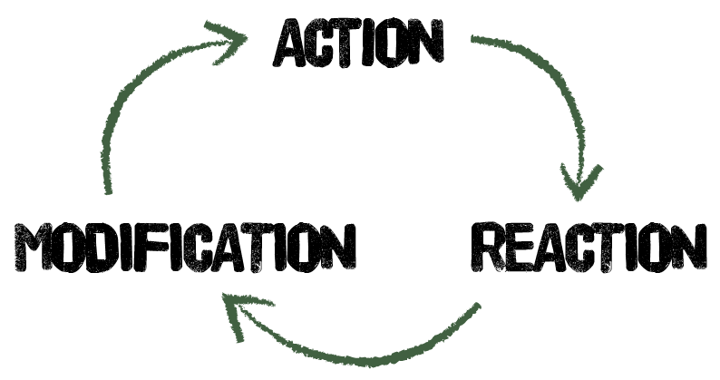
Modeling

Slide 65
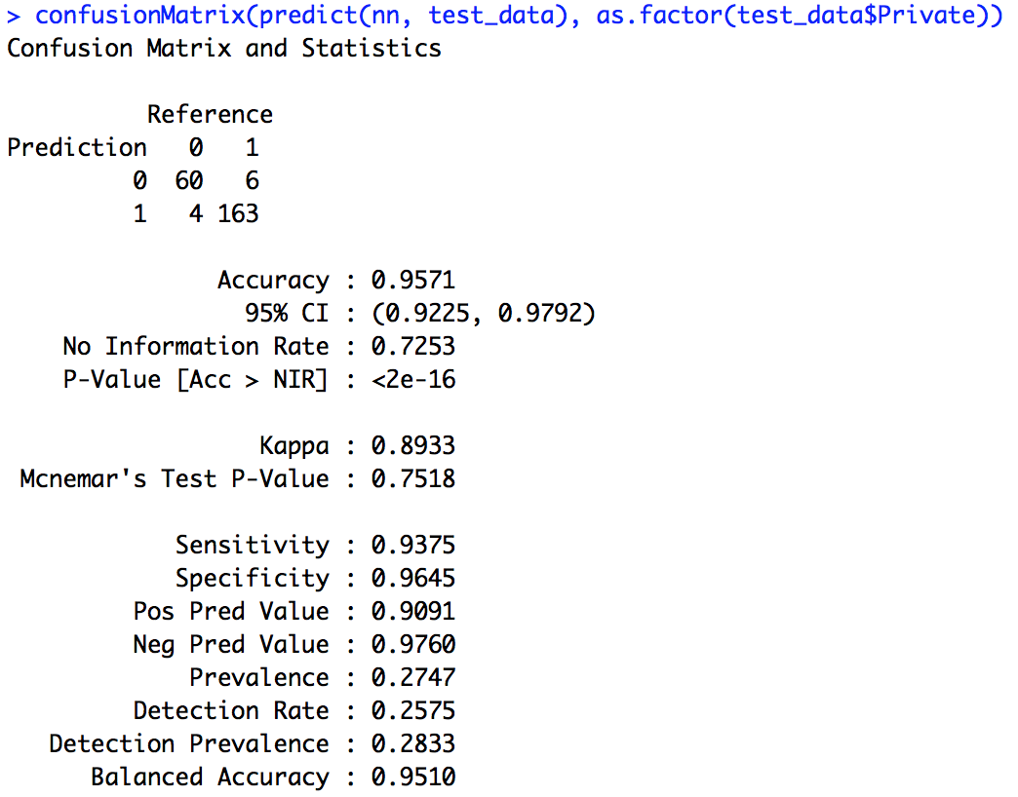


Predictions and Evaluations
Random Forest
Decision Tree

